Slide 1
COVID Cases & Vaccinations in India and Italy
By Tom Stockton, Ben Mullally, Alex Williams and Henry Horton

Slide 2
Context
Italy was first European country to lockdown- see how it reacted
India had lots of headlines about how bad the virus was there
Focused on total cases and total vaccinations as they both never decrease (likely to be easier to model)
Time series analysis is important to predict the future impacts of COVID

Slide 3
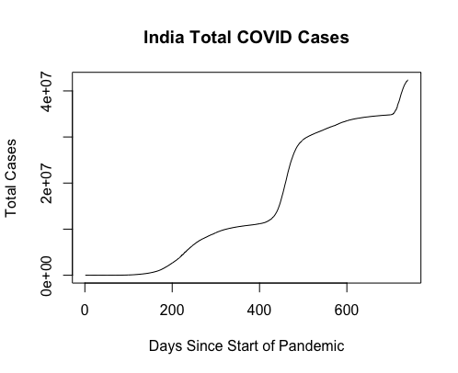
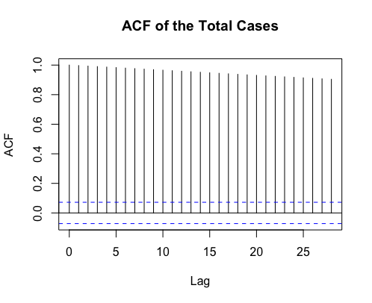
Pic of total cases graph and vaccinations
ADF Values
Differenced Log of Total Cases - 0.1557
Double Differenced Log of Total Cases - <0.01

Slide 4
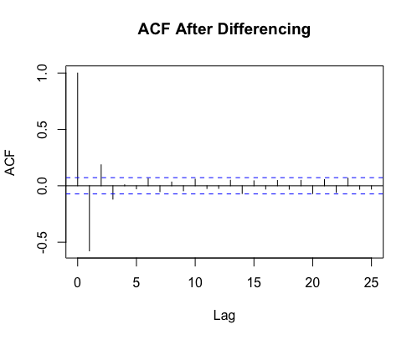
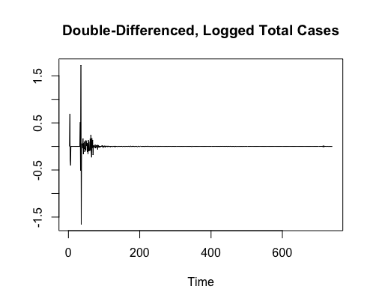
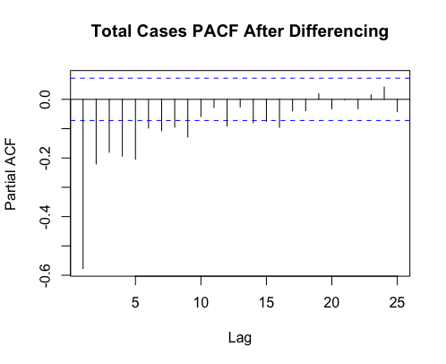
Differencing

Slide 5
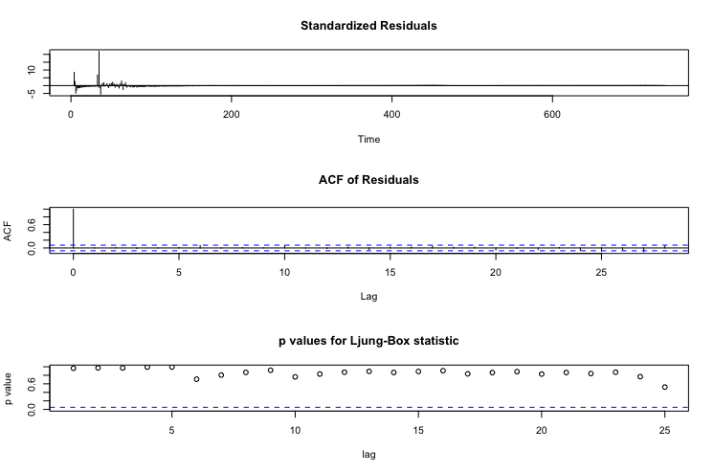

Slide 6
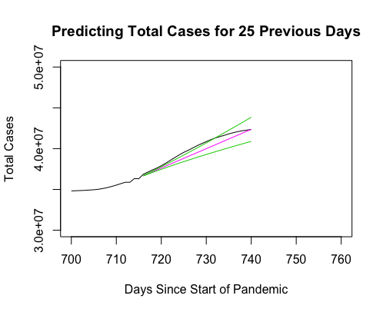
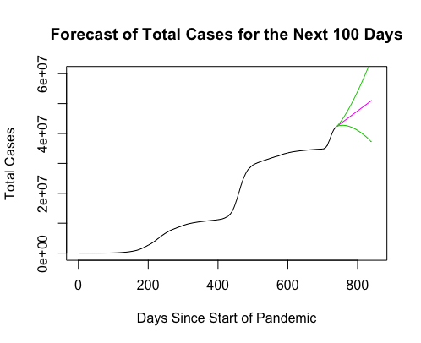
Errors:
Mean Absolute Error - 529,750.6 Root Mean Squared Error - 593,029.2

Slide 7
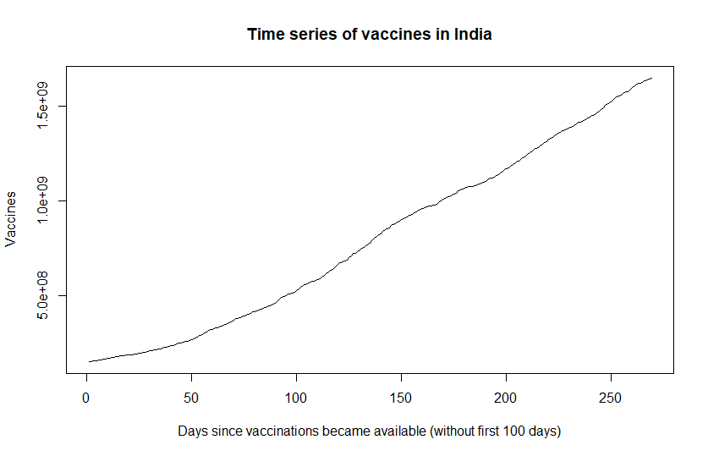
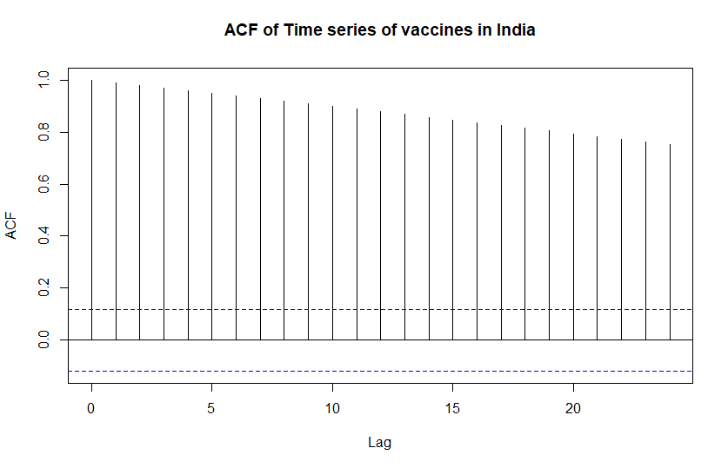
India Total Vaccines
ADF Values
Log of Total Vaccines - 0.9767
Differenced Log of Total Vaccines- 0.2464
Double Differenced Log of Total Vaccines- <0.01

Slide 8
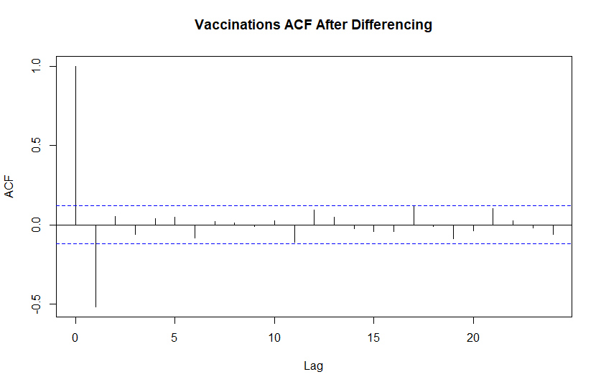
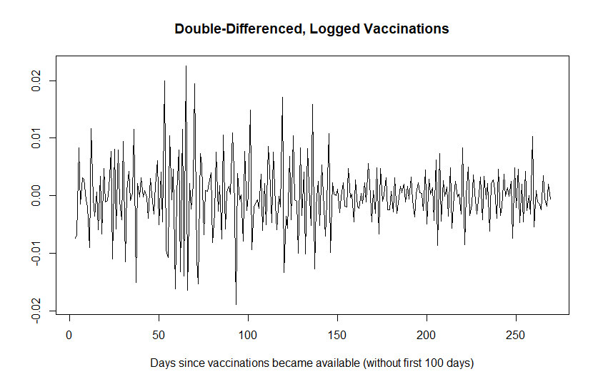
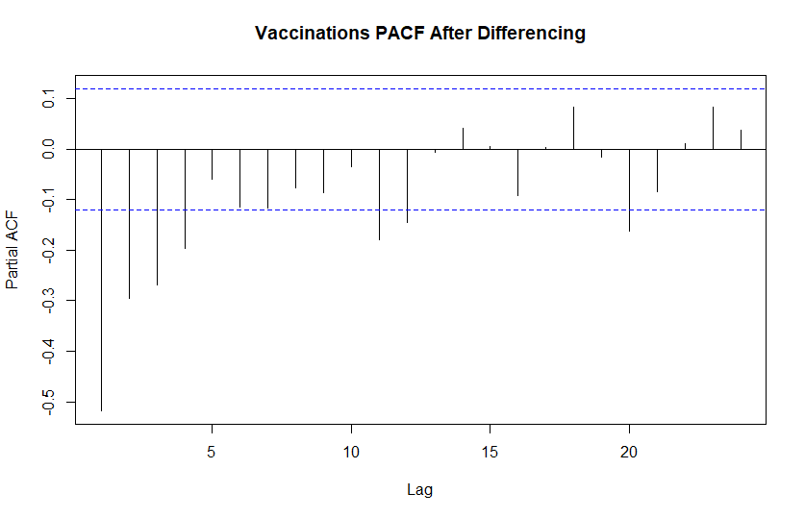
Differencing

Slide 9
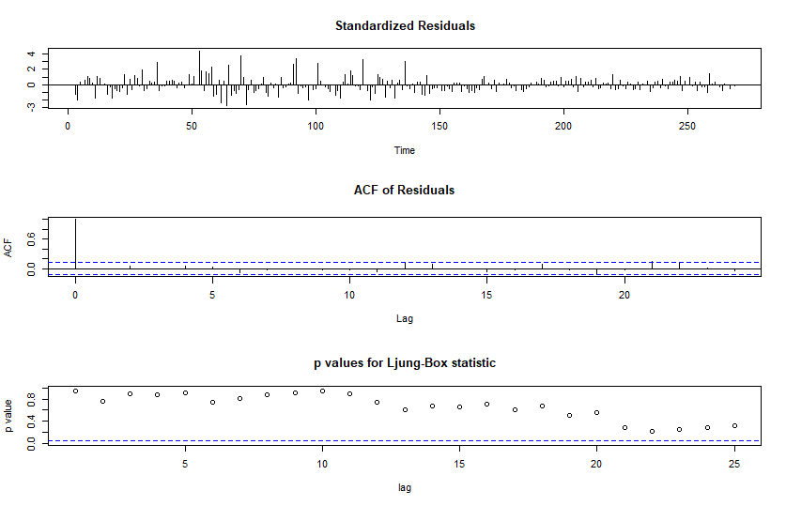

Slide 10
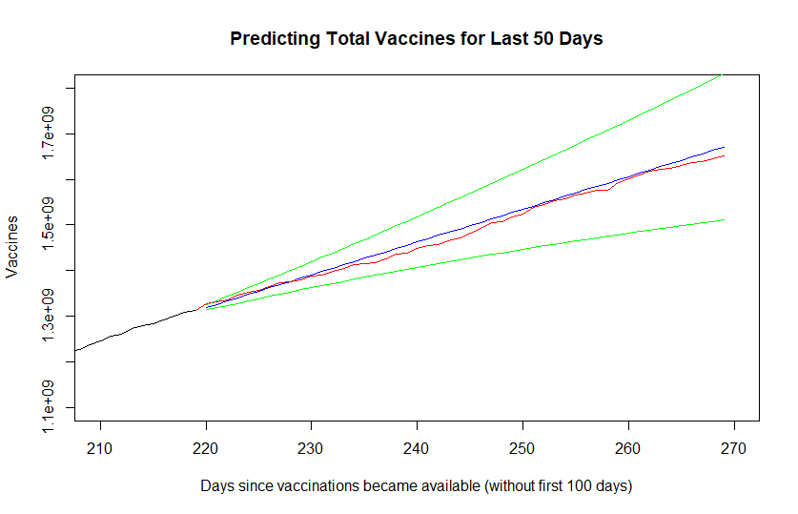
Prediction
Errors:
MAE = 20,857,926
RMSE = 49,072,082

Slide 11
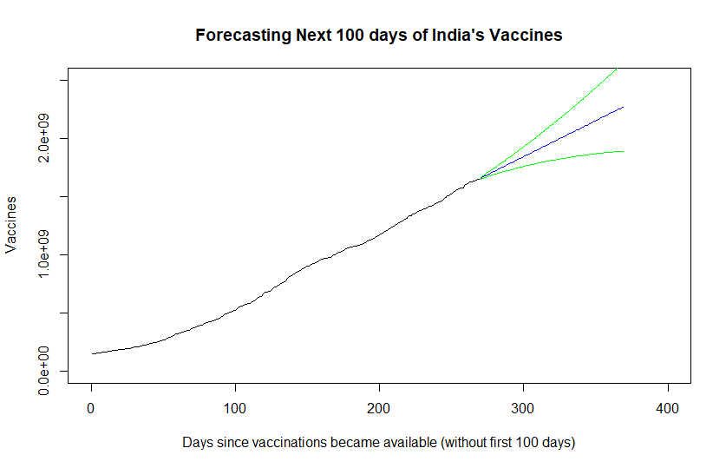
Forecasting future

Slide 12
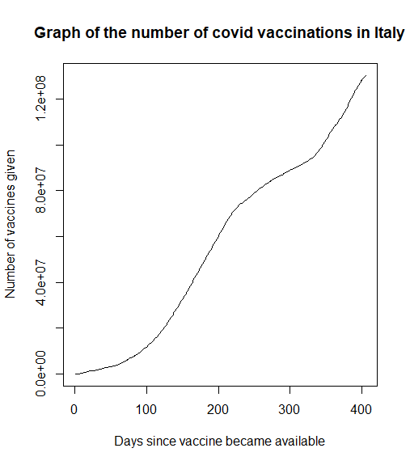
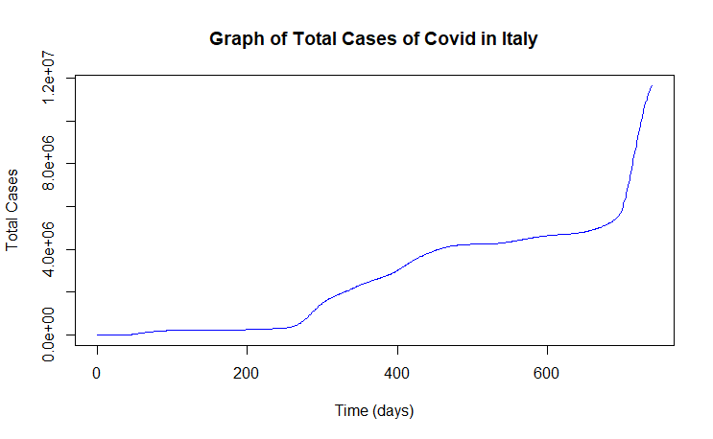
Italy

Slide 13
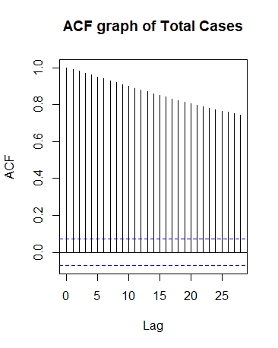
Analysis of Total Cases
ACF of original data
Very slight decrease
Need to take logs stabilise the variance in the time series.
Then we difference due to the decreasing ACF.

Slide 14
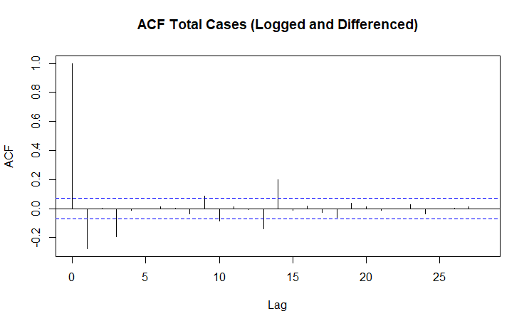
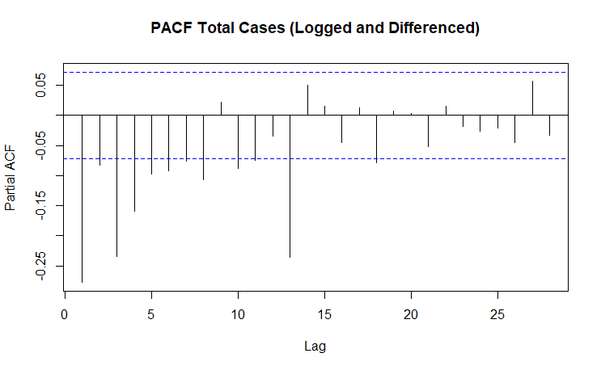
After taking the log of the data and differencing
ADF Values
Log of Total Vaccines - 0.2315
Differenced Log of Total Vaccines- 0.08176
Double Differenced Log of Total Cases - <0.01
Small peak at 14 on the ACF graph and a large peak at 13. As the AR(13) is a less complex model we choose this.

Slide 15
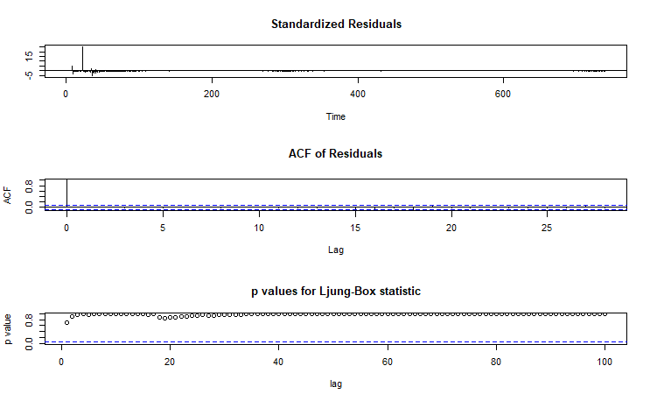
Model choice
Key points:
AR(13) model
Residuals have mean very close to 0.
ACFs are very low.
High Ljung-Box p values.
This indicates that this is i.i.d white noise with no trends remaining. So the model is suitable.
(Spike at the start indicates possible truncation.)

Slide 16
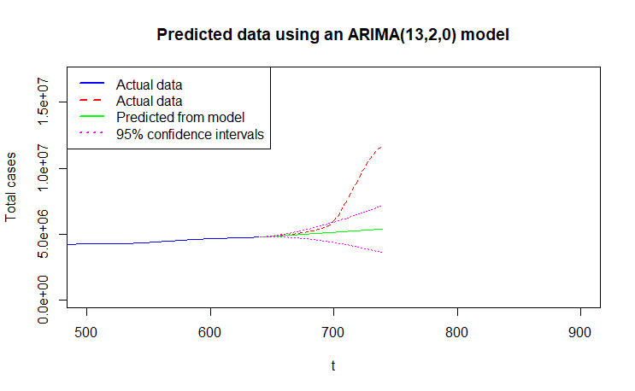
Prediction performance of the model
> MAE = 1598455
> RMSE = 2630132
The spike due to the Omicron variant led to an explosion of cases making the model make quite inaccurate predictions.

Slide 17
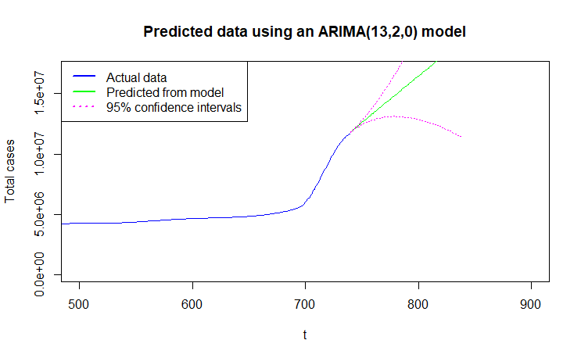
Forecasting next 100 days

Slide 18
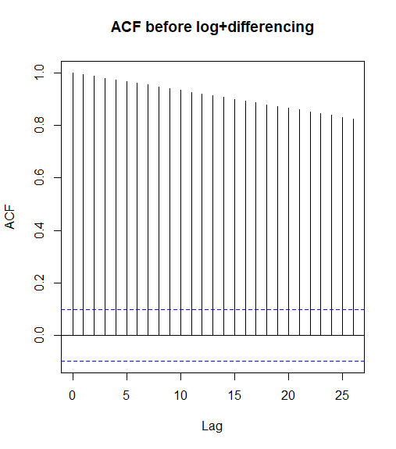
Analysis of Total Vaccinations
ACF of original data
Very slight decrease
Need to take logs stabilise the variance in the time series.
Then we difference due to the decreasing ACF.

Slide 19
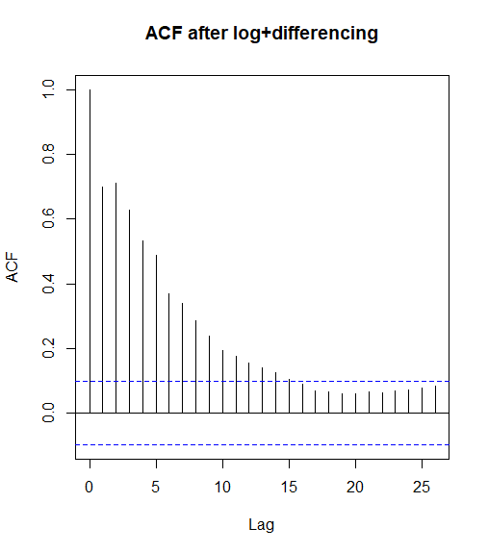
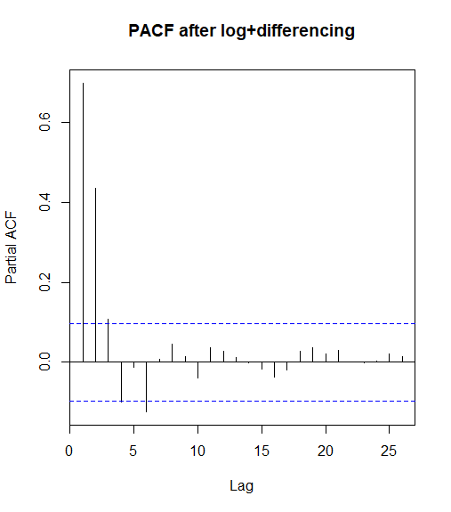
After taking the log of the data and differencing

Slide 20
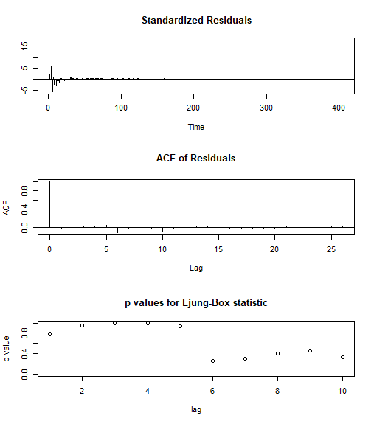
Model choice
Key points:
AR(3) model
Residuals have mean very close to 0
ACFs are almost non existent
High Ljung-Box p values.
So residuals are white noise and the model looks like it could work.

Slide 21
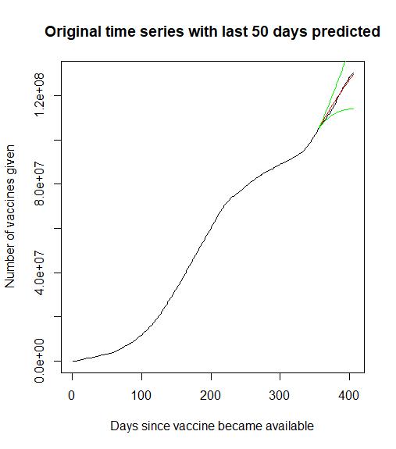
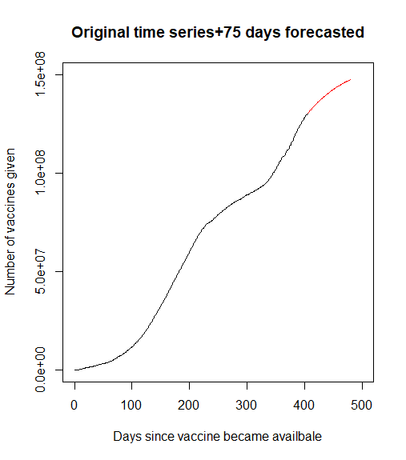
Prediction and Forecasting
Prediction :
MAE = 879,527
RMSE = 1,033,318

Slide 22
Questions?

